Slide 1
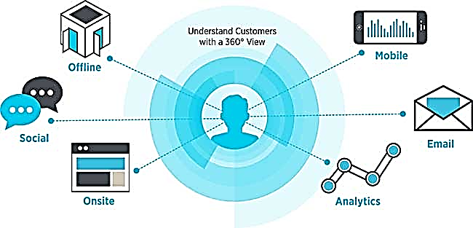

Customer 360^{ο}
June 2016

Slide 2

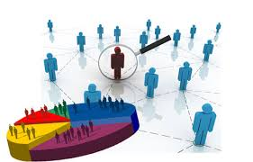

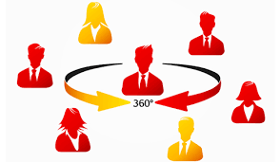





Background
The 360-degree customer view is a complete view of customers by aggregating data from the various touch points that a customer may use to contact a company to purchase products and receive service and support or touch points that a company uses to connect with the customer.
GAP Data Sources
Analytics Services
BI & Reporting
Transaction Data
Predictive Analytics
360 degree view of Customer
Browse Activity
Evergreen Attributes
Advertising, Marketing & Campaigns Data
Prescriptive Analytics
Social Media
Sentiment Analysis

Slide 3

Customer 360⁰ : Different users looking through different lens
Behavioral data of customers is consumed at different granularities by different end users.
End users can be
Store Representatives
Campaign Managers
Channel Managers
Operation’s Strategists
Customer Strategists
Customer Strategist
Customer behavior aggregated at Customer segment level – viewed over a period of time
Operations Strategist
Campaign Manager
Customer behavior aggregated at segment level – segments defined over Geography, Channel, Time period, etc.
Customer response behavior aggregated at different Campaign levels
Channel Manager
Store Representative
Customer response behavior aggregated as a function of Marketing Channel
Customer Journey at individual Customer level

Slide 4















Store Representative’s View - Know your Customer like a friend
LAST 6 MONTHS
PROFILE
Revenue | $ 420
Sales Transactions | 5
Returns Transactions | 1
Discount | 22%
Online Revenue | 28%
Store Revenue | 72%
Avg. Order Size | $ 80
Avg. Unit Retail | $ 35
2 / 5
$ 127
Last Purchase | 22 days
Tenure | 3Y
Acq. Brand | GP
Brands Interested | ON, GP
Expected LTV | High
Disc. Sens. | Low
Customer Segment | Uber
Attrition Risk | Medium
Divisions of interest | Women, Acc.
3 / 78
$ 155
PRODUCT RECOMMENDATIONS
2
20
10
5
EM
EM
EM
EM
EM
DM
Purchase
Browse
Social Media
Store, $82
Kids- 40%
Women-50%
Acc-10%
Kids
Women
GP Brand Promotion

Slide 5
Store Rep’s View- Use Cases
# | Use Case Epic Story | Capabilities Required
1 | The SA makes Product Recommendations ,as soon as the Customer is identified in the system | Ability to load recommendations from Predictive Models like Recommender Engines
2 | The SA knows the recent online activity (browse history / cart abandonment) of the customer, as soon as the Customer is identified in the system. The SA can engage with the customer based on products identified from the interactions | Ability to load data from Browse History/Cart abandonment
3 | The SA knows the recent return (Product Desc.) by the customer, as soon as the Customer is identified in the system. The SA engages with the Customer understanding the reason for return | Predictive Model which recommends similar products available in the Store Ability to load recommendations from the Predictive Model
4 | The SA knows about the recent feedbacks/social media from the customer, as soon as the Customer is identified in the system. | Ability to load data from feedbacks/social media activity
5 | The SA knows about the Discount Sensitivity of the customer, as soon as the Customer is identified in the system. This provides a basis for offering/not offering additional discounts(if possible) | Ability to load recommendations from Predictive Models predicting Discount Sensitivity
6 | The SA knows about the PLCC Redemption Points of the customer, as soon as the Customer is identified in the system. This gives the SA an opportunity to notify customer about how and when the points can be redeemed | Ability to load data from PLCC spends
7 | The SA knows the Loyalty Status (Acquired/Not Acquired) of the customer, as soon as the Customer is identified in the system. The SA can then seek consent from the Customer | Ability to load data from Purchase History and Loyalty enrollment

Slide 6
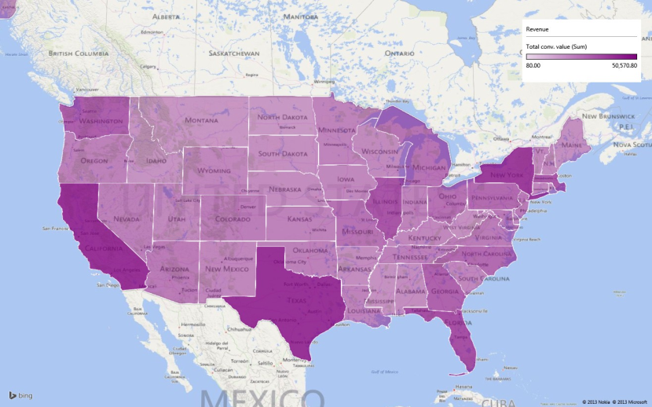
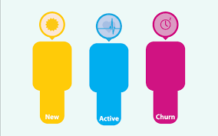
Strategist’s View – Where are we heading to?
Weeks before Q_{next} = 5
Quarterly Target
Online
DELTA
REVENUE DISTRIBUTION
Store
3M
14M
8M
Q₋₄ Q₋₃ Q₋₂ Q₋₁ QTD

Slide 7
Operational View – How can the Marketing Spend perform better?
High ROI and very low diminishing return effect. Spend on this channels should be increased
At the current level of spend the marginal returns are very low. Reduction in SEM and email should be considered
Sales($)
Spend
Carry over effects by activities

Slide 8

Customer’s Voice– What are the Customer’s talking?
SOCIAL MEDIA LISTENING
9.34%
POSITIVE
90.66% NEUTRAL
0.00% NEGATIVE
Customer satisfaction

Slide 9
Strategist’s View - Use Cases
# | Use Case Epic Story | Capabilities Required
1 | The Strategist knows the current Customer Lifecycle distribution(New/Active/Churn). He can identify focus areas – Acquisition/ Control churn/ Increase Active Engagement | Ability to aggregate and load data from Customer Acquisition and Transactions
2 | The Strategist knows the current Geographical distribution (Revenue/Customer Count/Complains/Promotion Response). He can identify focus geographies | Ability to aggregate and load relevant data
3 | The strategist knows the trend of key Business Metrics (Revenue/Customer Count/Complains/Promotion Response). He can identify focus areas/strategy for improvement/growth | Ability to aggregate and load relevant data
4 | The strategist knows the individual brand performance and targets. He can make Brand investment decisions accordingly | Ability to aggregate and load relevant data
5 | The strategist knows about the performance of individual Marketing Channels. He can make investment decisions accordingly | Ability to build Media Mix models
6 | The Strategist is updated about the Social Media activities – He can take appropriate action to react to a viral online post/s | Ability to aggregate and load relevant data
7 | The Strategist knows key Customer pain-point areas by looking at the complain themes. He can identify appropriate action items to address most of them | Ability to aggregate and load relevant data
8 | Investment on New Technology Platform (e.g.: Mobile) | Ability to aggregate and load relevant data

Slide 10
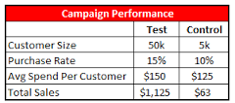

Campaigner’s View – How Campaigns perform ? (Below the line)
Month over Month Performance of Campaign
Revenue ($ 100k)
# of Coupons redeemed
Sales

Slide 11
Channel’s View – How Channels perform ? (Above the line)
Comparing day parts
Internet’s reach is more than TV between 6 and 8 AM

